Slide 1
Outline Of Today’s Discussion
Amplitude, Frequency & Phase

Slide 2
Part 1
Amplitude, Frequency, & Phase

Slide 3
Amplitude, Freq, Phase
Amplitude is the physical dimension of a wave that indicates the “peak to trough” displacement.
In acoustics, the greater the amplitude, the greater the intensity.
Here’s a graph of two waves differing in intensity (i.e., amplitude)….

Slide 4
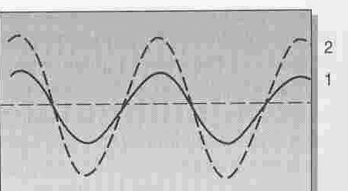
Amplitude, Freq, Phase
Amplitude Differences
Perceptually, the greater the intensity
the louder the sound.

Slide 5
Amplitude, Freq, Phase
Now, let’s consider where intensity comes from.
When an object vibrates in a medium (say a tuning fork vibrating in air), it displaces air molecules nearby.
The displacements can be thought of as local changes in pressure, i.e., the number of air molecules per unit space.
Here’s a diagram showing such changes…

Slide 6
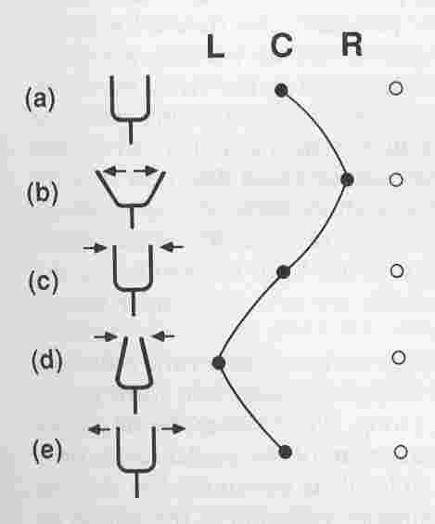
Amplitude, Freq, Phase
Filled circles = displaced air molecules:
Open circles = nearby, stationary air molecules.

Slide 7
Amplitude, Freq, Phase
high pressure
low pressure
Filled circles = displaced air molecules:
Open circles = nearby, stationary air molecules.

Slide 8
Amplitude, Freq, Phase
Compression (high pressure)
Rarefaction (low pressure)
Filled circles = displaced air molecules:
Open circles = nearby, stationary air molecules.

Slide 9
Amplitude, Freq, Phase
To reiterate…
Compressions are local regions of high pressure (many air molecules per unit space).
Rarefactions are local regions of low pressure (few air molecules per unit space).

Slide 10
Amplitude, Freq, Phase
There is a mathematical relationship between pressure and intensity:
Intensity is proportional to pressure squared.
The human ear can respond to a 15 log unit range of intensities!!!!
Reminder: A log unit is also called an “order of magnitude”. In our class, a log unit will imply a ten-fold difference. So 3 log units is a 1,000-fold difference.

Slide 11
Amplitude, Freq, Phase
Here’s a potential pop quiz question that extends over a few slides…:
A thumb-tack weighs 1 gram.
A Volkswagon Beetle weighs 1,350 kilograms, or 1,350,000 grams…

Slide 12
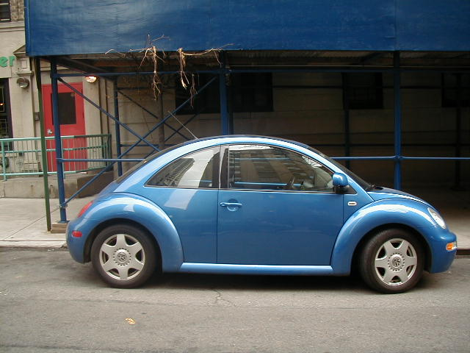
Amplitude, Freq, Phase
This car weighs 1,350,000 grams

Slide 13
Amplitude, Freq, Phase
Assume we want to make a scale that can weigh objects over a range comparable to that of the human auditory system’s range of intensities -namely, 10 to the 15th power.
On the low end, we’ll have a thumb-tack that weighs 1 gram.
Potential Pop Quiz Question: How many Volkswagon Beetles will we need to represent the high end? Show Your Work!
This exercise will give you an intuitive feel for the range of intensities that you and I can hear.

Slide 14
Amplitude, Freq, Phase
The decibel is the unit of measure corresponding to “displacement”.
Actually, the measure is the Bel (after Alexander Grahm Bel), but the Bel is so large that we chop it up into ten pieces…the decibel.
Sometimes decibels measure displacement in terms of pressure -Sound Pressure Level (SPL).
Other times, decibels measure displacement in terms of intensity -Intensity Level (IL).
In all cases, a decibel is the ratio of two quantities; either two pressures, or two intensities.

Slide 15
Amplitude, Freq, Phase
The decibel formula for two pressures is this
dB = 20 * log( pressure X / standard pressure)
The standard pressure of 20 microPascals is the softest pressure that young adult humans can hear.
Potential Pop Quiz Question: If rustling leaves have a dB SPL of 20, then what must be the value inside the parenthesis?

Slide 16
Amplitude, Freq, Phase
The decibel formula for two pressures is this
dB = 20 * log( pressure X / standard pressure)
The standard pressure of 20 microPascals is the softest pressure that young adult humans can hear.
Question: If rustling leaves have a dB SPL of 20, then what must be the value inside the parenthesis?
Answer: 10, since the log of 10 = 1, and 20*1= 20, which is the dB SPL of rustling leaves (left side of formula).
So, rustling leaves create a 10-fold increase in sound pressure.

Slide 17
Amplitude, Freq, Phase
Importantly, the decibel is ALWAYS a relative measure.
In our class, we’ll talk about the the relation between two sound pressures…(dB SPL).
We could have, instead, chosen the relation of two intensities…(dB IL).
Now let’s consider frequency…

Slide 18
Amplitude, Freq, Phase
As you know, frequency can be defined as the number of cycles per time, typically, cycles per second.
The unit of temporal frequency is Hertz.
Here are two stimuli that differ in temporal frequency…

Slide 19
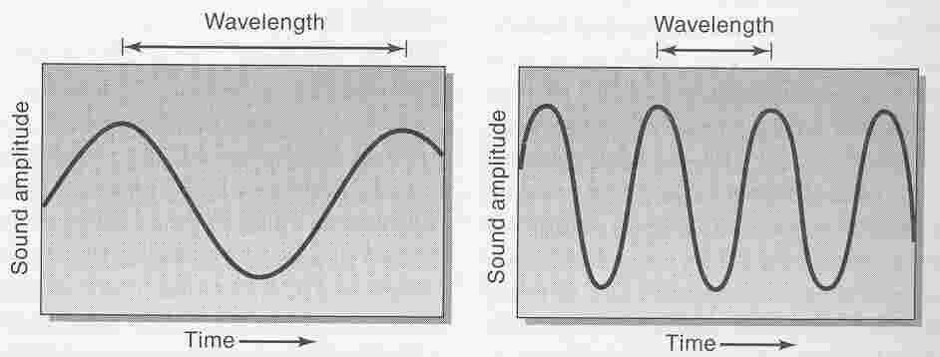
Amplitude, Freq, Phase
Frequency Differences

Slide 20
Amplitude, Freq, Phase
Frequency Differences
Which one will be heard as higher in pitch?

Slide 21
Amplitude, Freq, Phase
So pitch is the perceptual correlate of frequency: High frequency high pitch, low frequency low pitch.
There is a reciprocal relation between frequency and wavelength.
Wavelength = speed of sound / frequency:
Wavelength = (distance / time) / (cycles / time)
Wavelength = distance per cycle
Frequency = speed of sound / wavelength:
Frequency = (distance / time) / (distance / cycle)
Frequency = cycles per time
In the following graph, note the “negative” slope of the line that shows wavelength as a function of frequency…

Slide 22
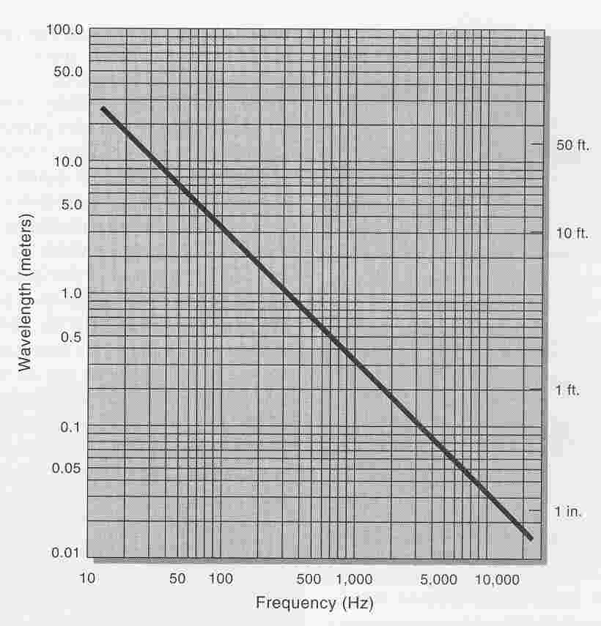
Amplitude, Freq, Phase
Frequency and wavelength are inversely related.

Slide 23
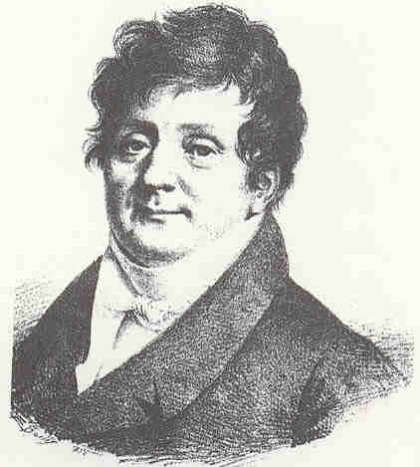
Amplitude, Freq, Phase
Let’s see a Fourier analysis on a complex acoustic sound.

Slide 24
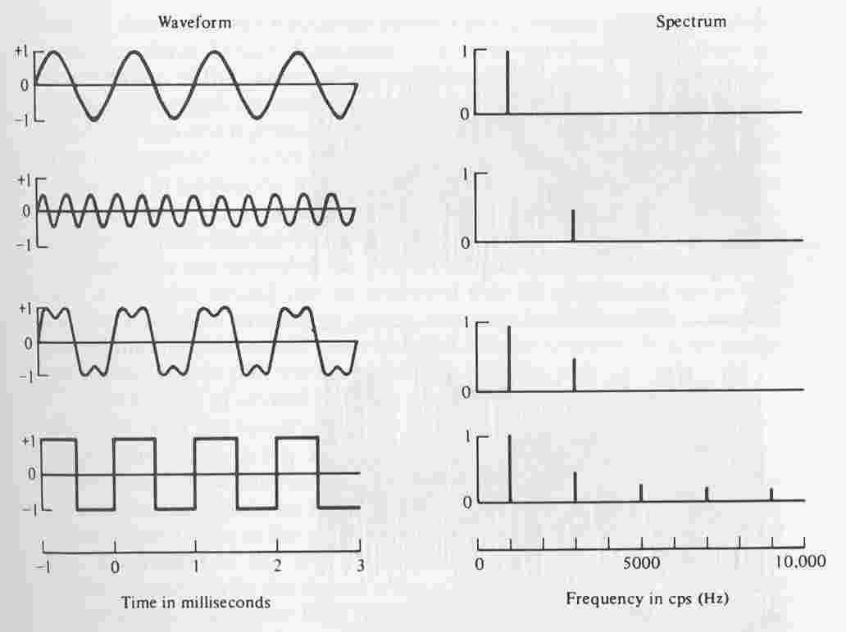
Amplitude, Freq, Phase

Slide 25
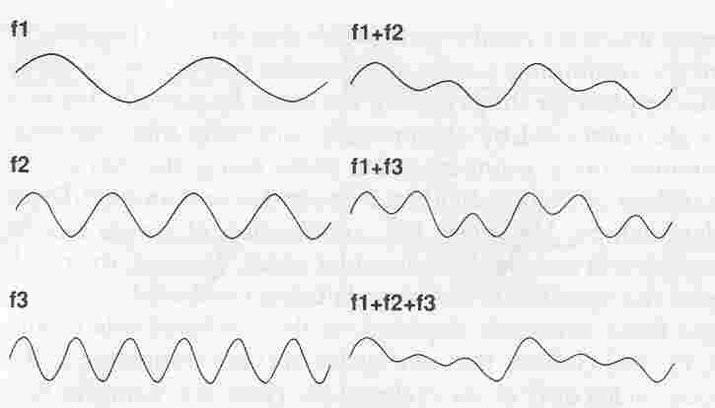
Amplitude, Freq, Phase
We can make complex
Sounds from sine waves

Slide 26
Amplitude, Freq, Phase
Finally, let’s consider Phase…the aspect of a wave that pertains to relative position (in time or space).
Phase is often expressed in angular units.
Here’s a diagram relating the phase of sine waves to angular shifts…

Slide 27
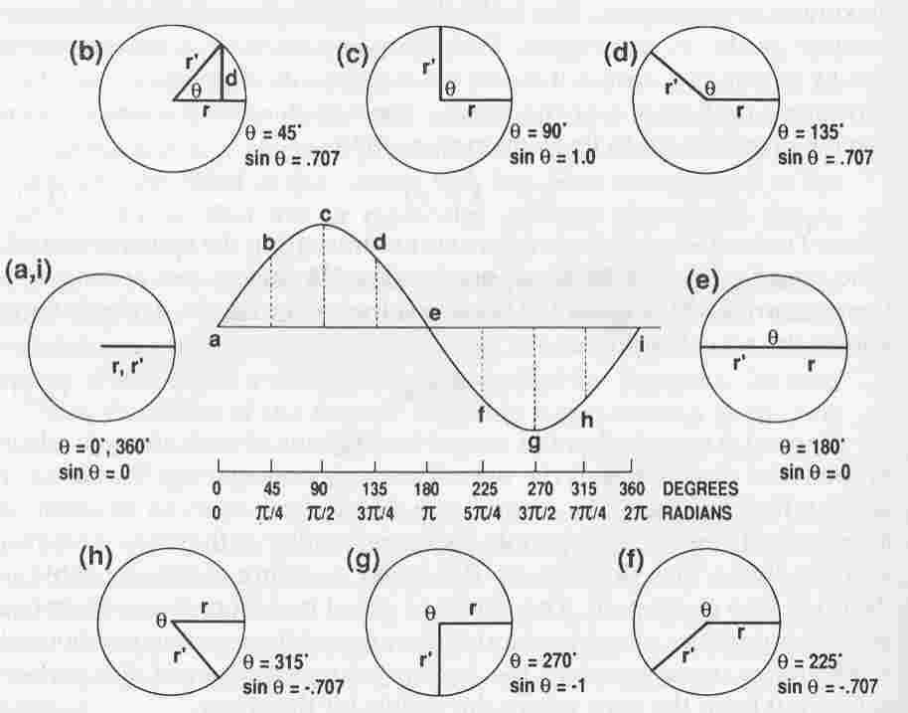
Amplitude, Freq, Phase
Phase Angle

Slide 28
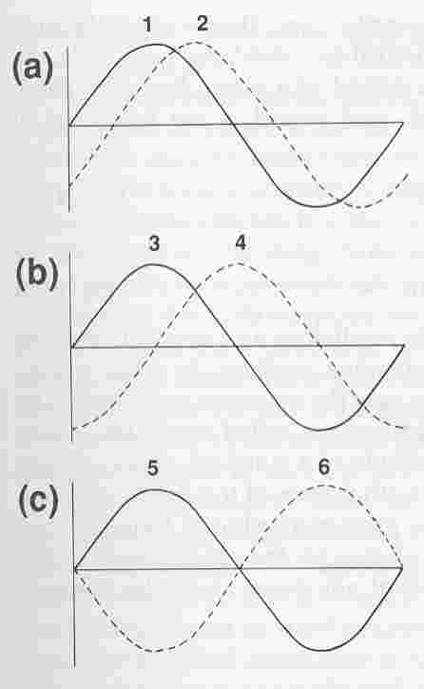
Amplitude, Freq, Phase
45 Degree Phase Difference
90 Degree Phase Difference
180 Degree Phase Difference
Phase differences are critical for
our ability to localize sounds.

